Slide 1

Realtech Housing
GROUP 1 Titans

Slide 2
problem statement:
Determining the price of the house through several influencing factors

Slide 3
The purpose of solving this problem:
To determine the intrinsic value of properties.

Slide 4
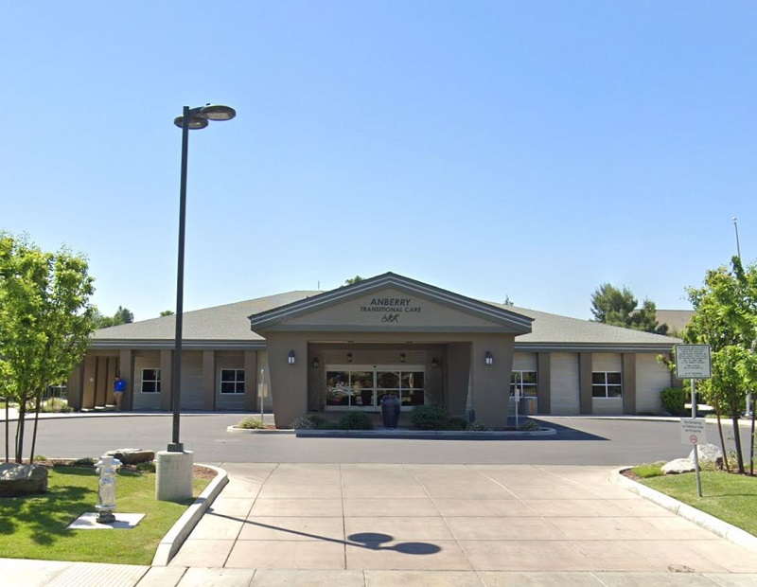
California Housing Data Set Description
longitude | A measure of how far west a house is; a higher value is farther west
latitude | A measure of how far north a house is; a higher value is farther north
housing Median Age | Median age of a house within a block; a lower number is a newer building
total Rooms | Total number of rooms within a block
total Bedrooms | Total number of bedrooms within a block
population | Total number of people residing within a block
households | Total number of households, a group of people residing within a home unit, for a block
median Income | Median income for households within a block of houses (measured in tens of thousands of US Dollars)
median House Value | Median house value for households within a block (measured in US Dollars)

Slide 5
Selected Model:
Neural Networks Model.
Linear Regression Model.
The purpose of selecting this Model:
Because the Neural network model can deal with regression problems easily.

Slide 6

Data cleansing process Involves:

Slide 7
What is Mean_squared_error in Python?
The Mean Squared Error (MSE) or Mean Squared Deviation (MSD) of an estimator measures the average of error squares i.e. the average squared difference between the estimated values and true value. It is a risk function, corresponding to the expected value of the squared error loss

Slide 8

THANK YOU
GROUP 1 Titans
1. Asma Harthi 2. Amal Alqahtani 3. Dhamya Alhemely 4. Haneen Abuallam 5. Khalid Alomari 6. Zainab Alharbi

